Slide 1
Flight Delay Prediction Machine Learning Project

Slide 2
EDA on Geolocation: A Comparison of Average and Total Delay Minutes and Delay Times Across Different Airports

Slide 3
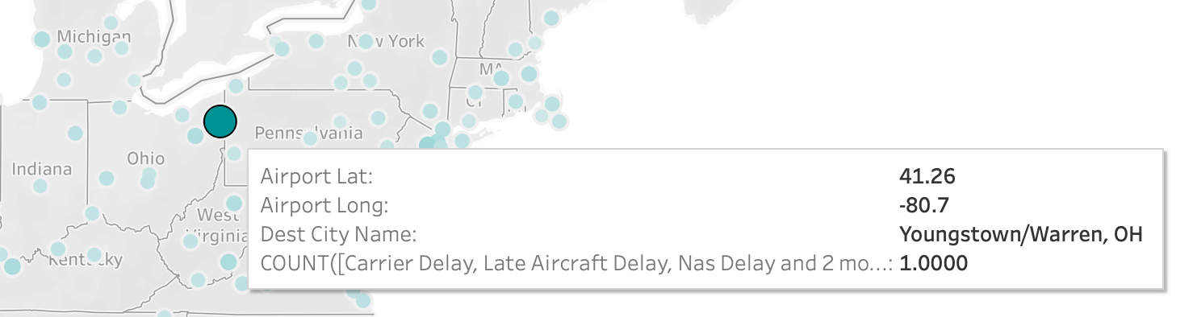
High Delay Rates in Certain Airport's Arrival Flights

Slide 4
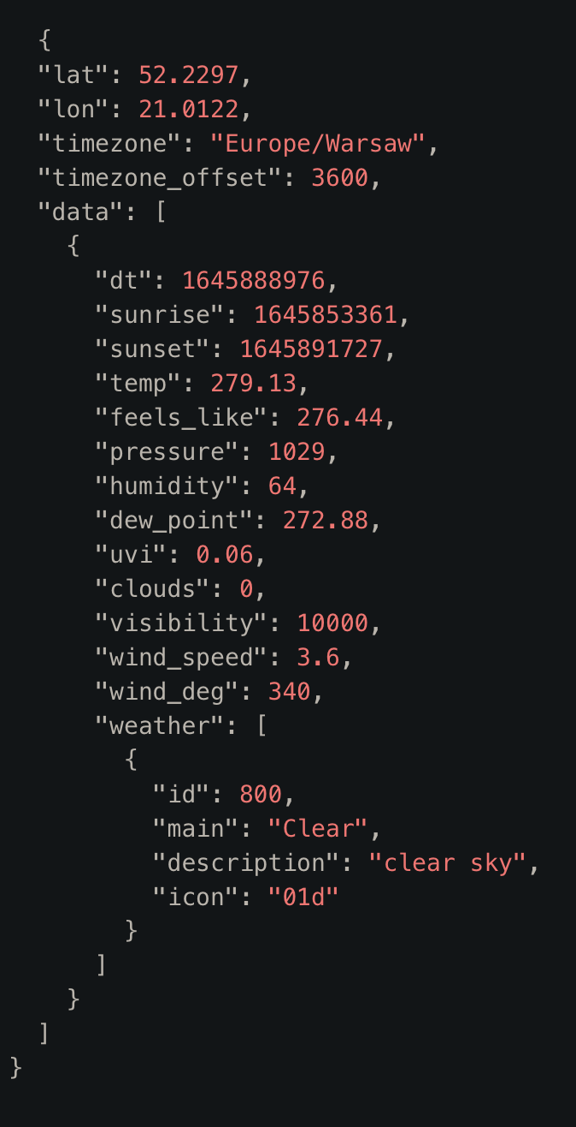
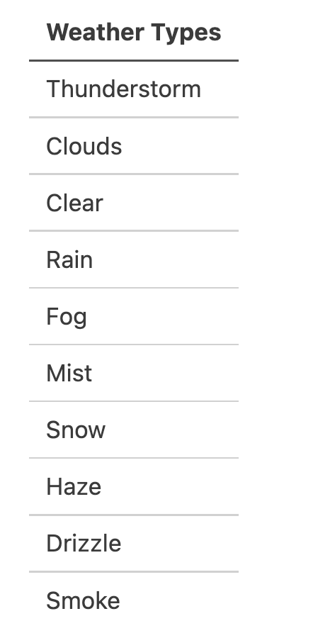
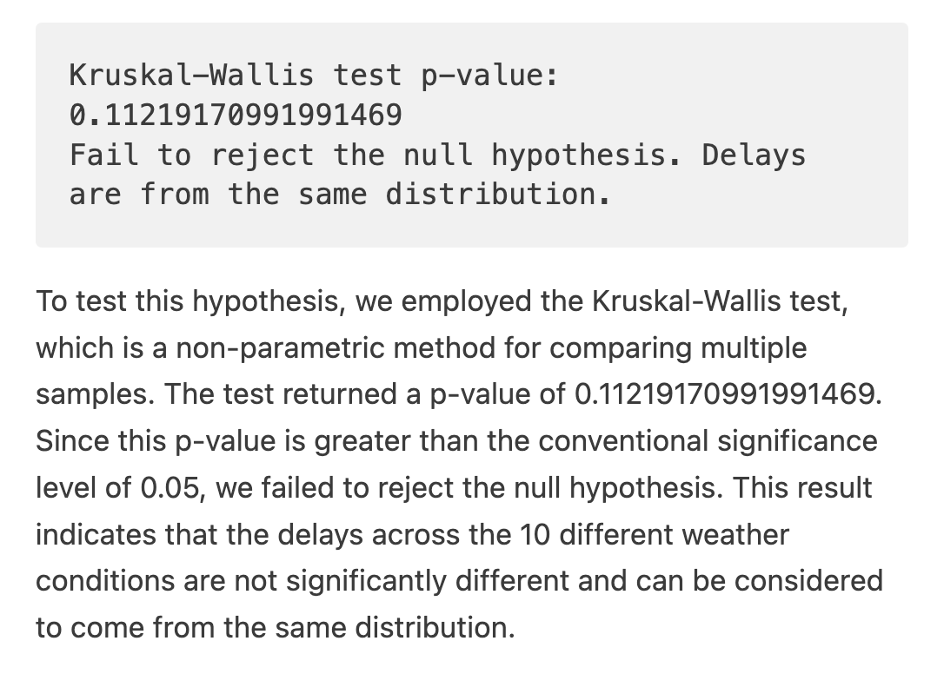
OpenWeatherMap API

Slide 5
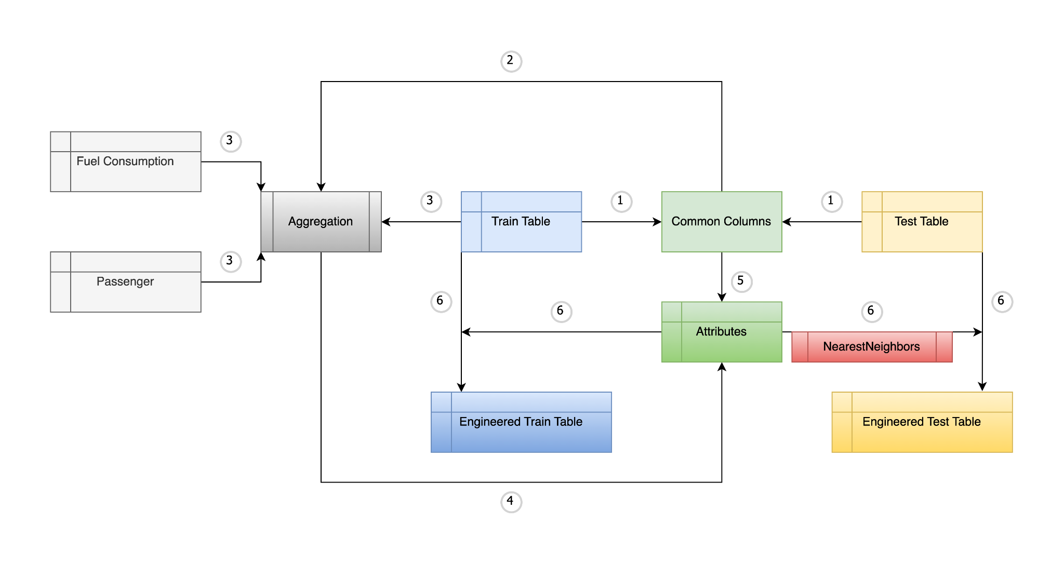
Feature Engineering Workflow

Slide 6
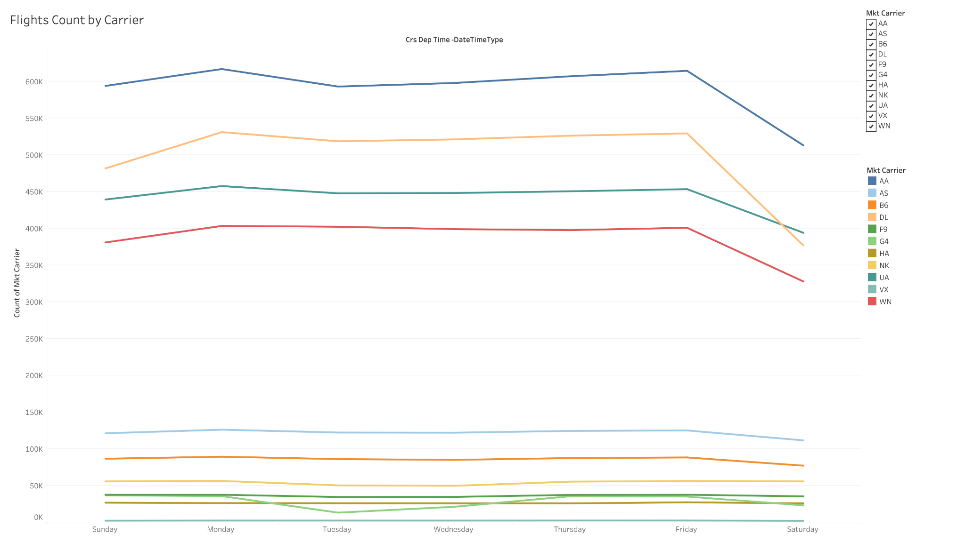

Slide 7
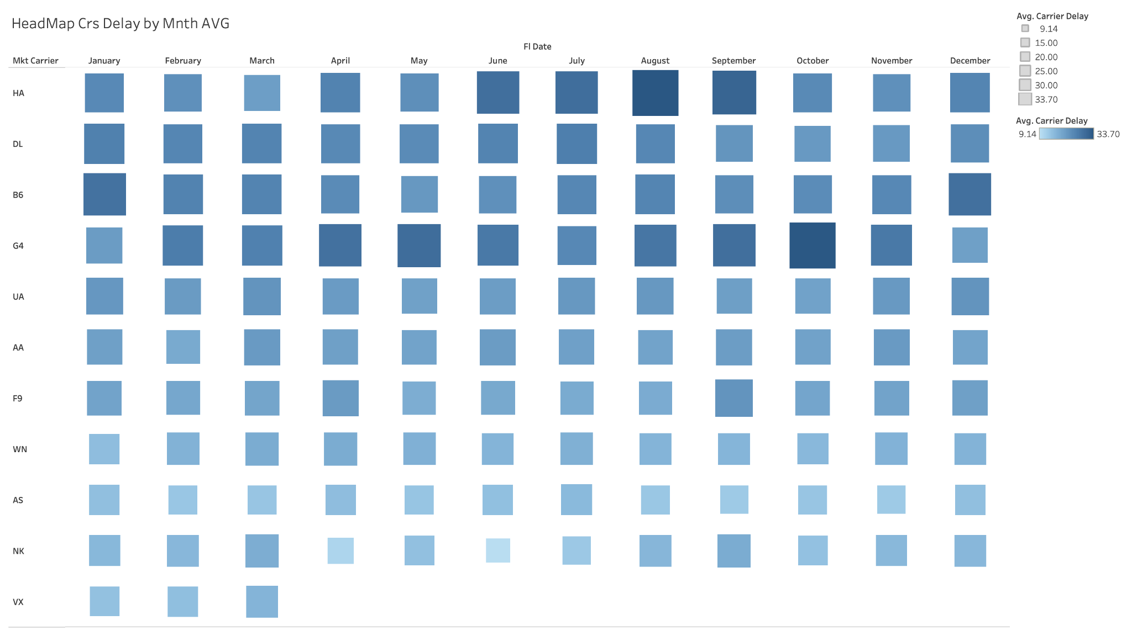
Monthly Average Delay Minutes by Carrier: Heatmap

Slide 8
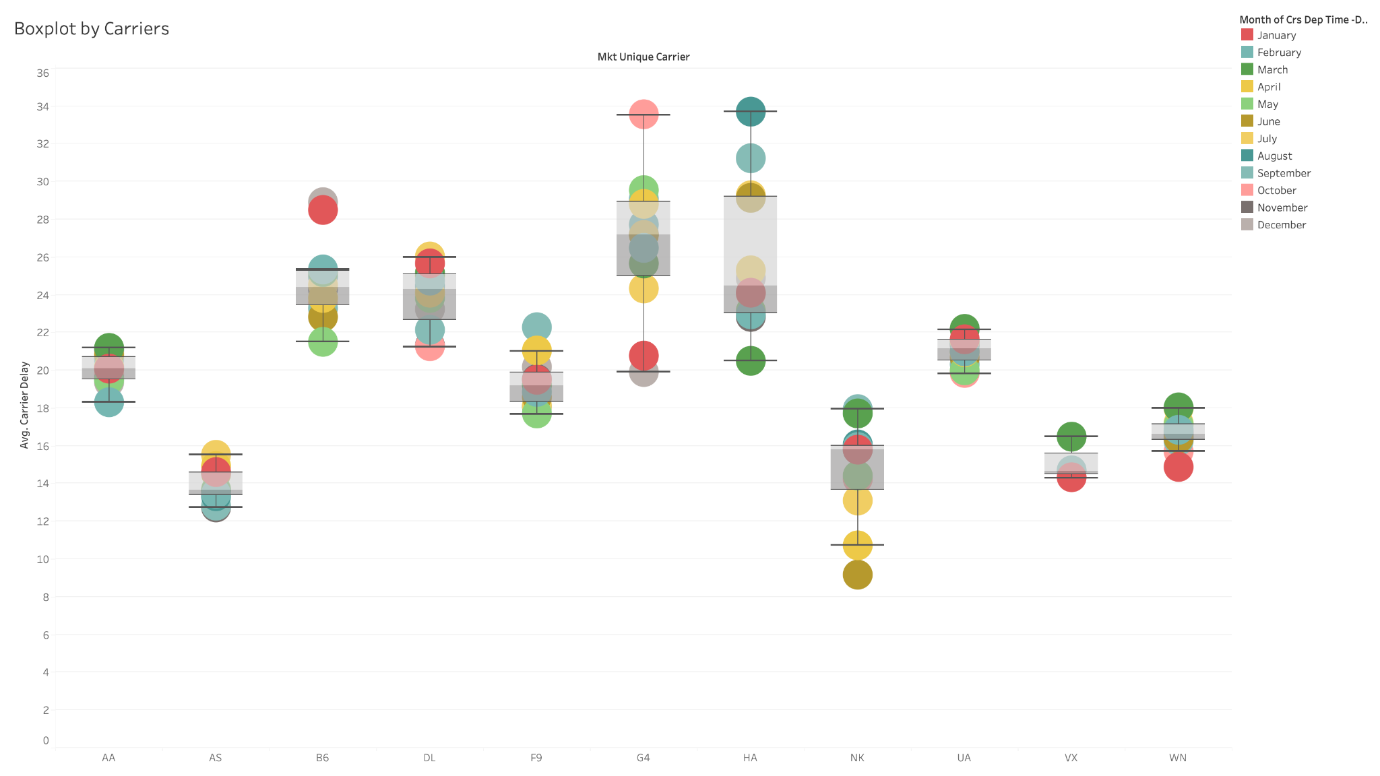

Slide 9
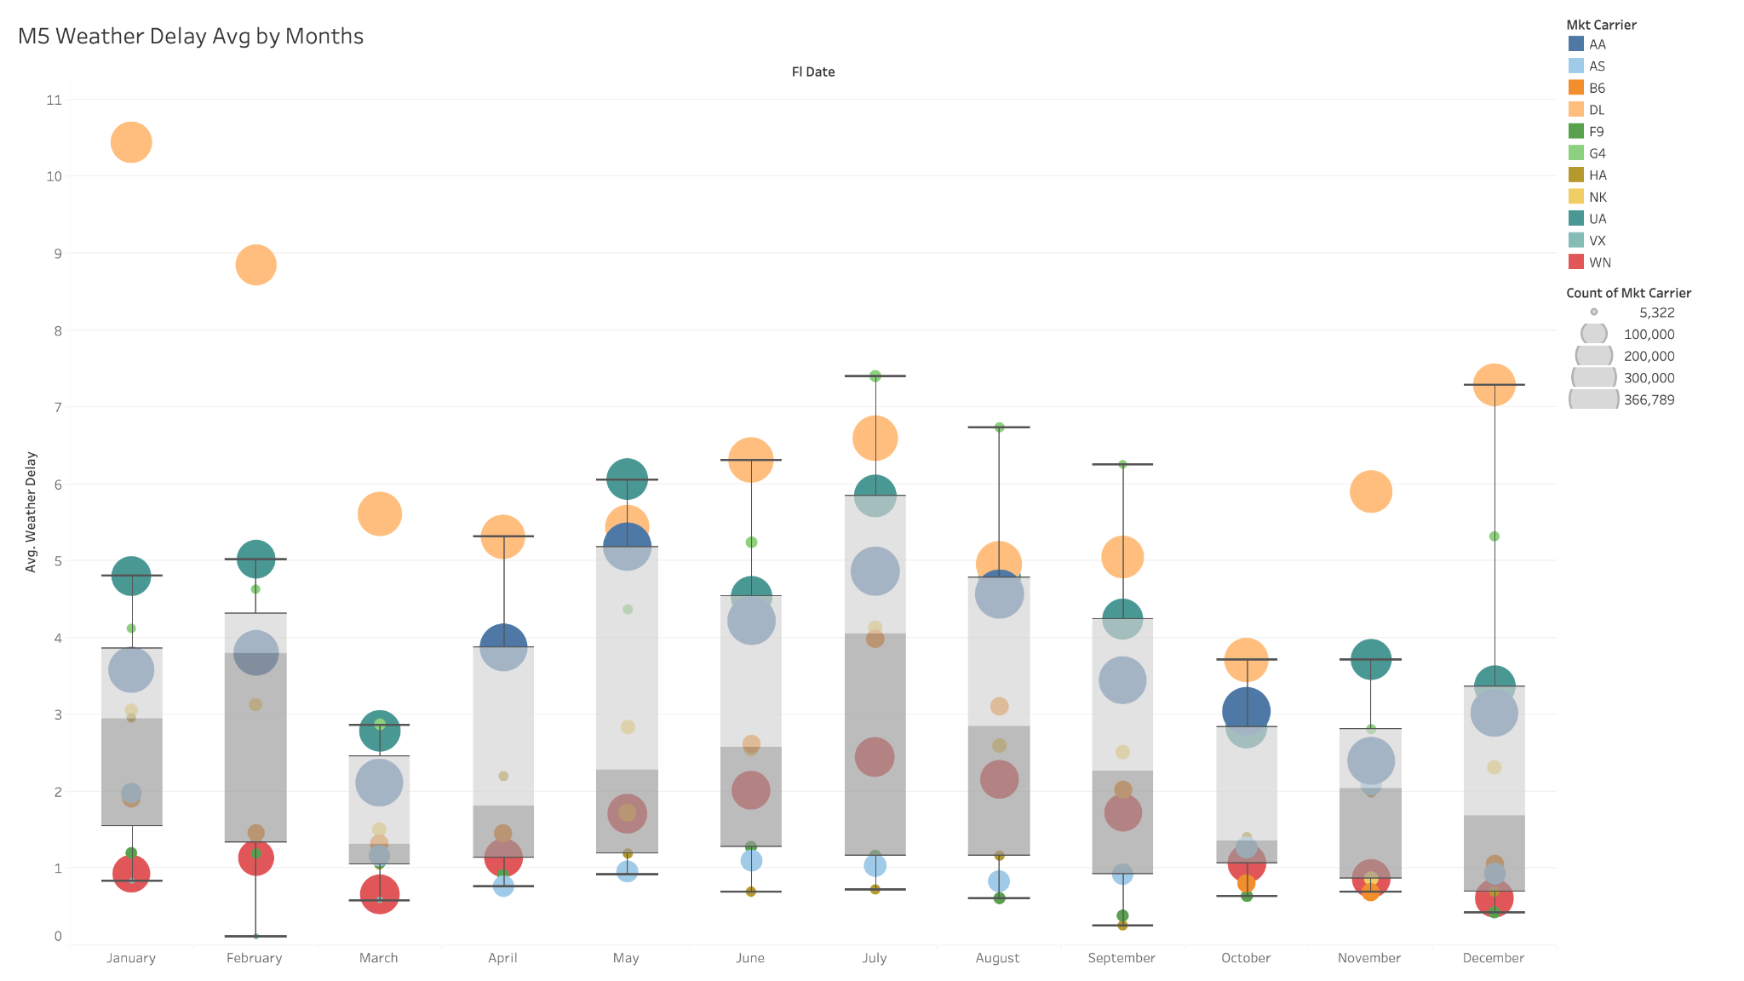

Slide 10
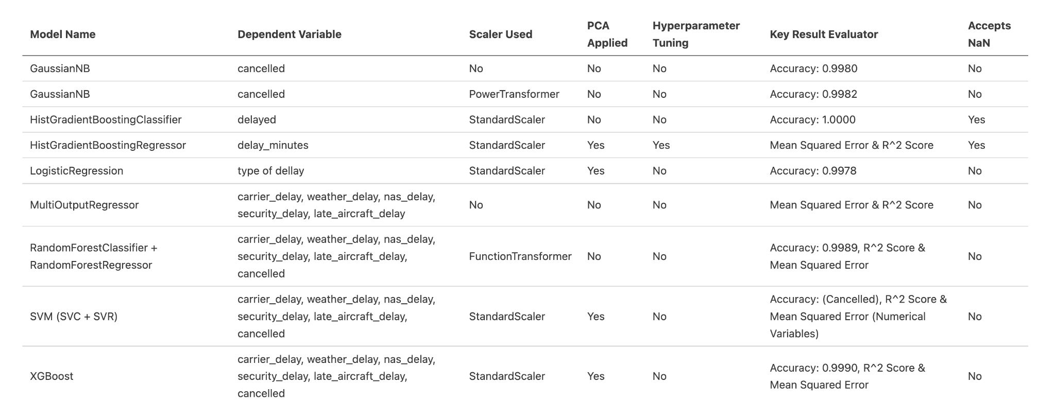
Model Comparison: Performance Metrics and Features

Slide 11
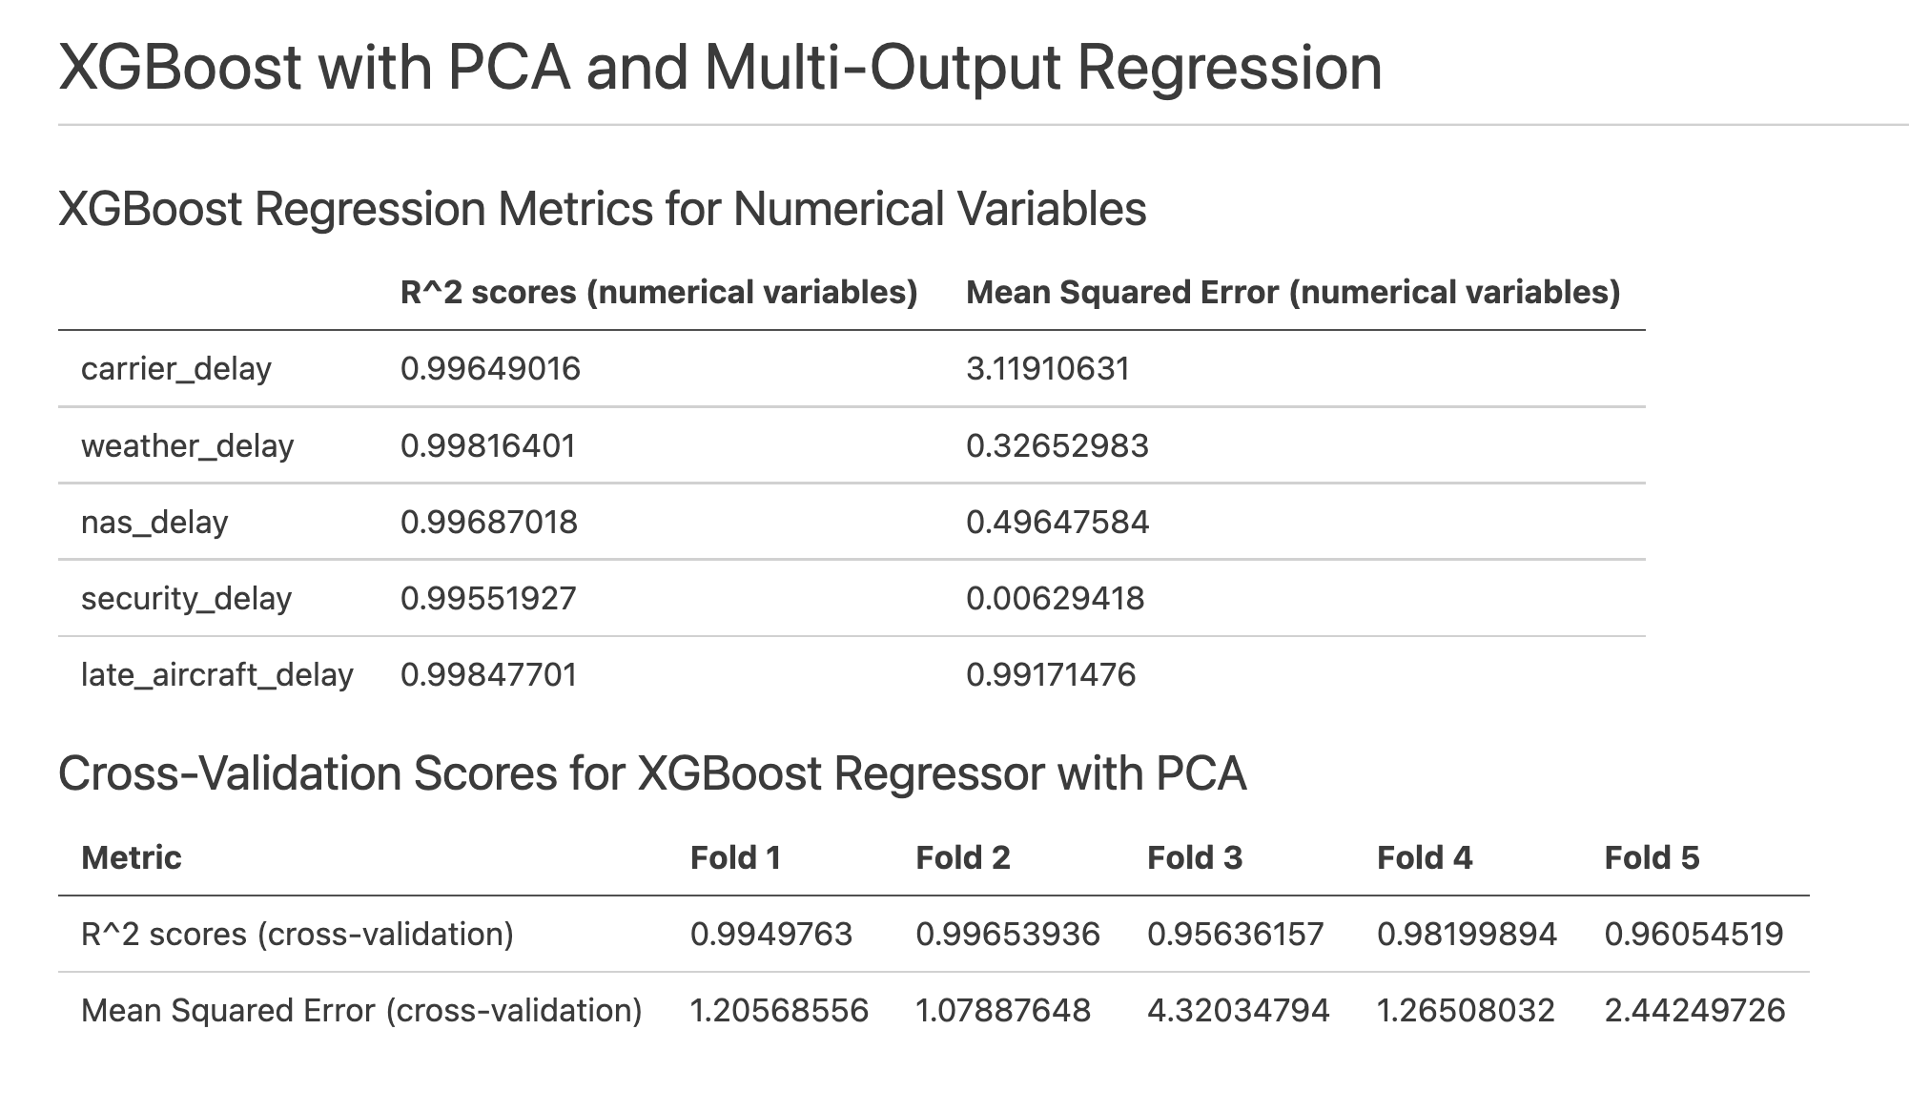
Cross Validation

Slide 12
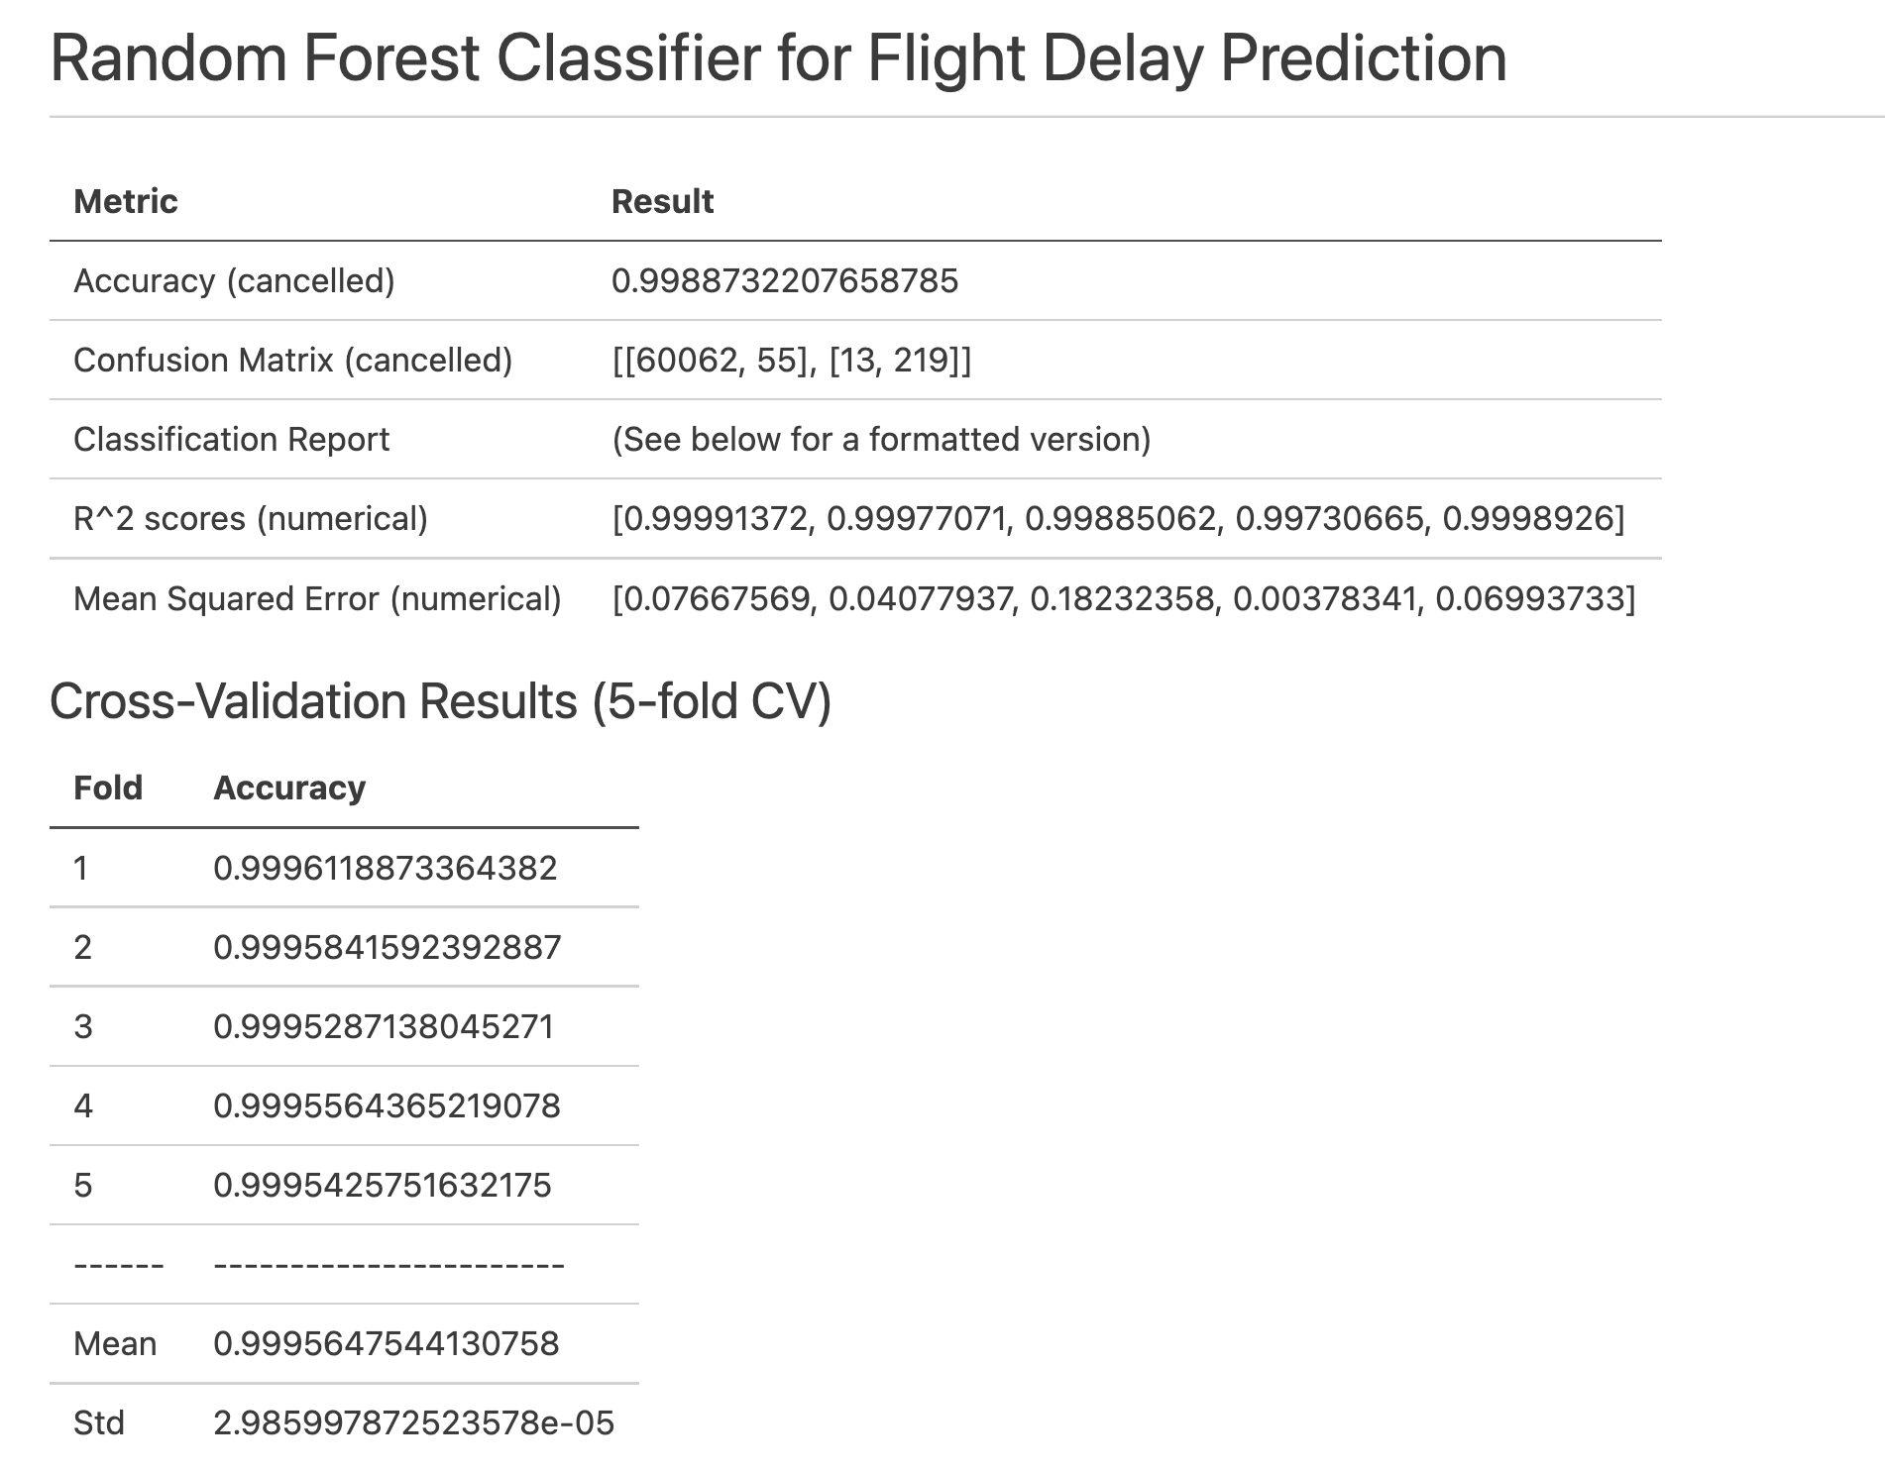

Slide 13
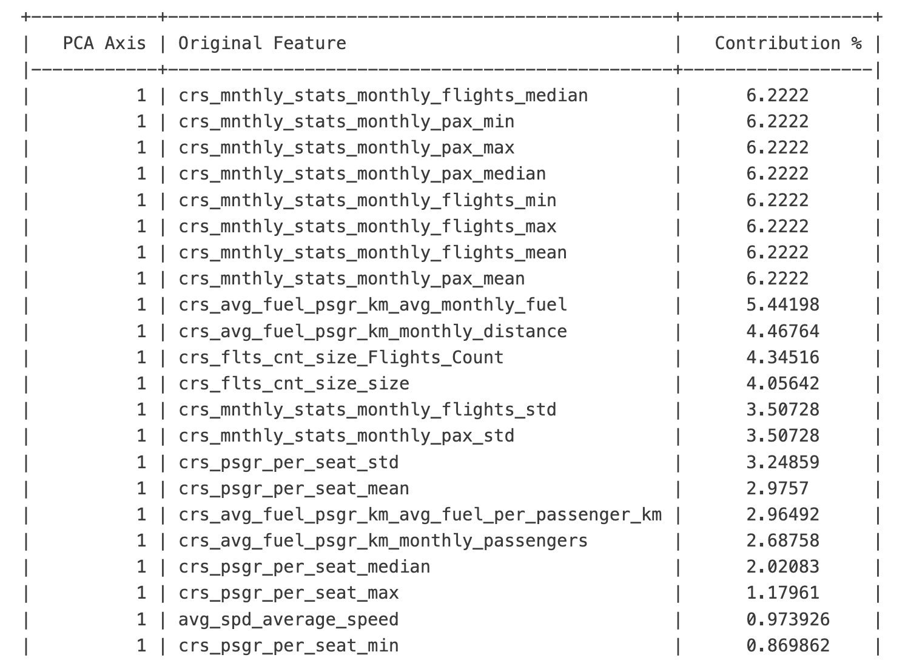
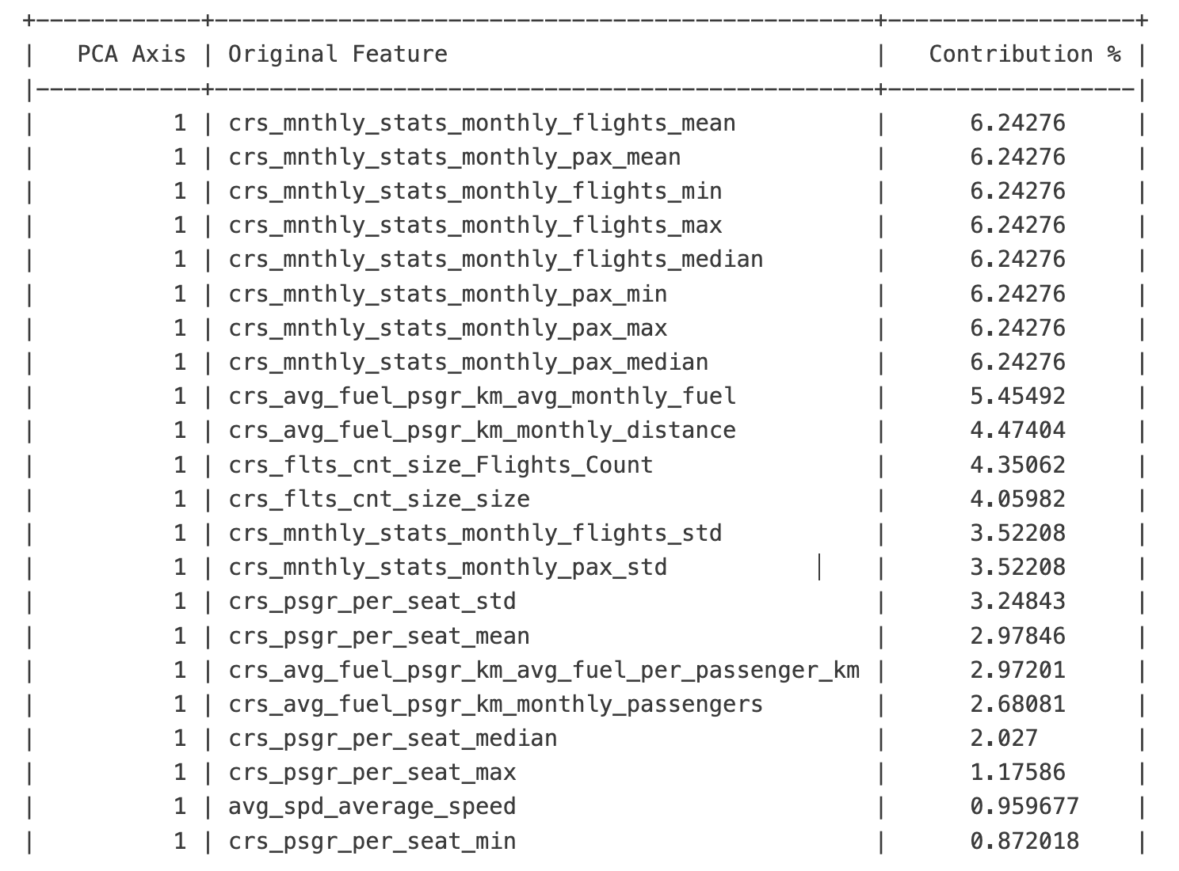
PCA Contribution Analysis
MultiOutputRegressor Model
HistGradientBoostingClassifier Model

